Slide 1
Different types of Learning

Slide 2
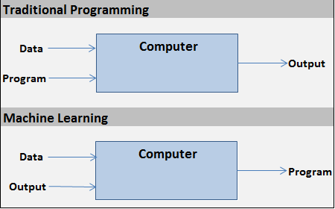
Machine Learning v/s Traditional Program

Slide 3
Different types of learning
Supervised learning
UnSupervised learning
Reinforcement Learning

Slide 4
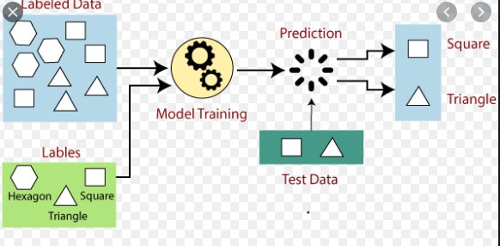
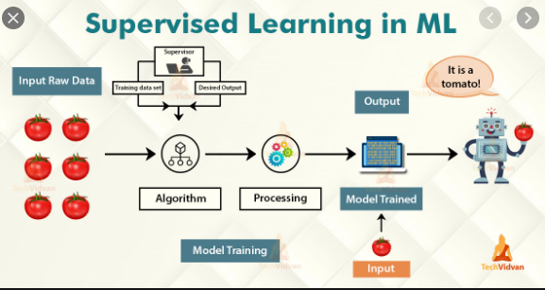
Supervised Learning
A “supervised learning” is so called because the process of an algorithm learning from the training dataset can be thought of as a teacher supervising the learning process.

Slide 5
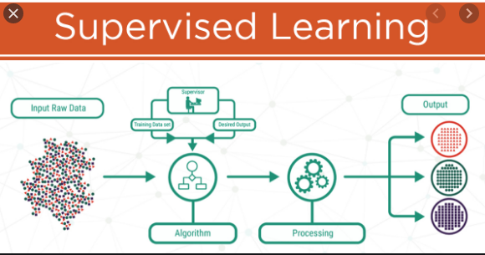
Supervised Learning
Supervised learning is the machine learning task of learning a function that maps an input to an output based on example input-output pairs.
In supervised learning, each example in the training set is a pair consisting of an input object (typically a vector) and an output value.
A supervised learning algorithm analyzes the training data and produces a function, which can be used for mapping new examples.
In the optimal case, the function will correctly determine the class labels for unseen instances.

Slide 6
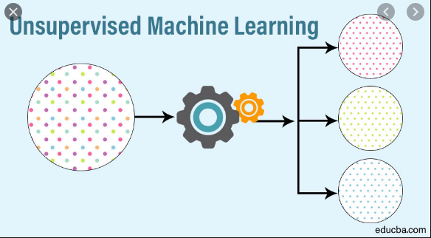
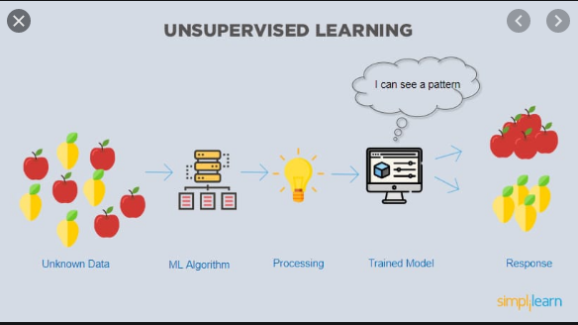
Unsupervised Learning

Slide 7
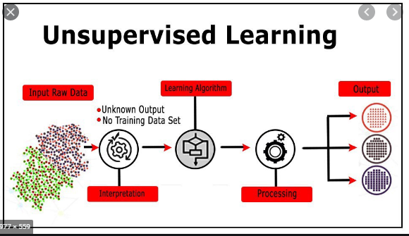
Unsupervised Learning
Unsupervised learning is a type of machine learning algorithm used to draw inferences from datasets consisting of input data without labeled responses.
In unsupervised learning algorithms, a classification or categorization is not included in the observations.

Slide 8
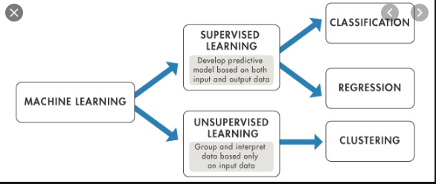

Slide 9
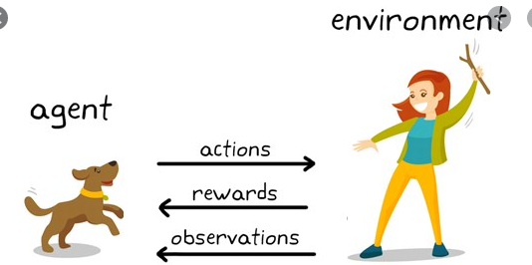
Reinforcement learning
Reinforcement learning is the problem of getting an agent to act in the world so as to maximize its rewards.
A learner (the program) is not told what actions to take as in most forms of machine learning, but instead must discover which actions yield the most reward by trying them.

Slide 10
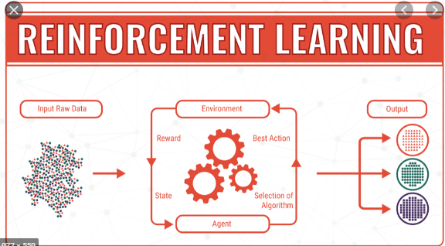
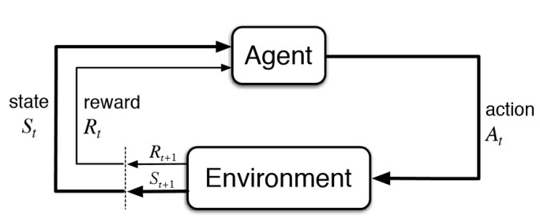
Reinforcement learning
Consider teaching a dog a new trick: we cannot tell it what to do, but we can reward/punish it if it does the right/wrong thing. It has to find out what it did that made it get the reward/punishment.
We can use a similar method to train computers to do many tasks, such as playing backgammon or chess, scheduling jobs, and controlling robot limbs.
Reinforcement learning is different from supervised learning. Supervised learning is learning from examples provided by a knowledgeable expert.

Slide 11
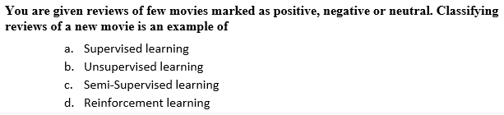
Q1
Supervised Learning

Slide 12
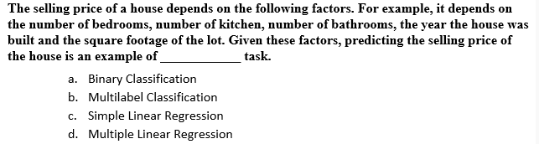
Q2
Multiple Linear Regression

Slide 13
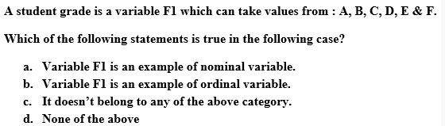
Q3
Ordinal Variable

Slide 14
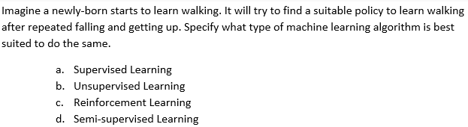
Q4
Reinforcement Learning

Slide 15
Short Answer Questions
1.What is meant by “learning” in the context of machine learning?
2. List out the types of machine learning.
3. Distinguish between classification and regression.
4. What are the differences between supervised and unsupervised learning?
5. What is meant by supervised classification?
6. Explain supervised learning with an example.
7. What do you mean by reinforcement learning?
8. What is an association rule?
9. Explain the concept of Association rule learning. Give the names of two algorithms for generating association rules.
10. What is a classification problem in machine learning. Illustrate with an example.

Slide 16
Short Answer Questions
11. Give three examples of classification problems from real life situations.
12. What is a discriminant in a classification problem?
13. List three machine learning algorithms for solving classification problems.
14. What is a binary classification problem? Explain with an example. Give also an example for a classification problem which is not binary.
15. What is regression problem. What are the different types of regression?

Slide 17
Long Answer Questions
1. Give a definition of the term “machine learning”. Explain with an example the concept of learning in the context of machine learning.
2. Describe the basic components of the machine learning process.
3. Describe in detail applications of machine learning in any three different knowledge domains.
4. Describe with an example the concept of association rule learning. Explain how it is made use of in real life situations.
5. What is the classification problem in machine learning? Describe three real life situations in different domains where such problems arise.
6. What is meant by a discriminant of a classification problem? Illustrate the idea with examples.
7. Describe in detail with examples the different types of learning like the supervised learning,etc.

